Slide 1
Project-based Learning
Pete Dobbins

Slide 2
Outline
Goal
Learning Preferences
Example Scenarios

Slide 3
What is our Goal?
First, in your own words, what is learning?

Slide 4
What is our Goal?
First, in your own words, what is learning?
Possibly…
Understanding new information
Recalling things we used to forget
Viewing something we had not before
Being able to do something we could not before

Slide 5

Goals $→$ Evaluate, How, Technique?
Just as there are different ways to express what learning is, there are also different ways to:
Evaluate what has been learned.
Approach how to learn.
Identify some learning techniques / modes of instruction.

Slide 6
Bloom’s Taxonomy
One framework for structured learning objectives, or in other words, how we might go about learning.

Slide 7
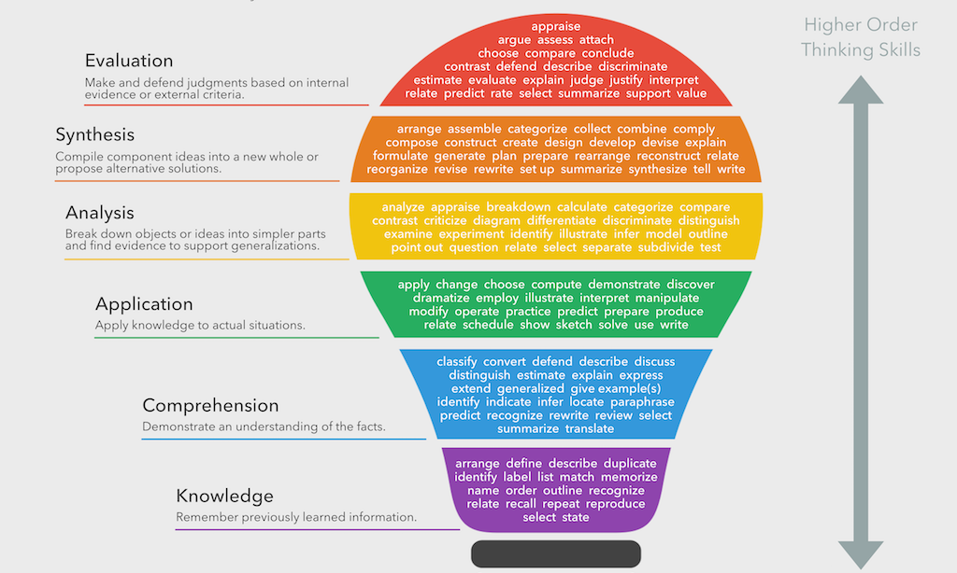
Bloom’s Taxonomy
One framework for structured learning objectives, or in other words, how we might go about learning.

Slide 8
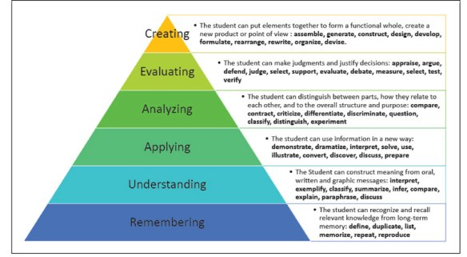
Bloom’s Taxonomy
One framework for structured learning objectives, or in other words, how we might go about learning.

Slide 9
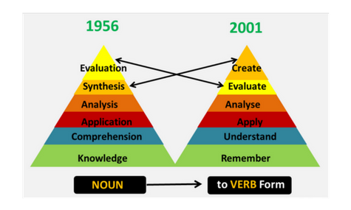
Bloom’s Taxonomy
One framework for structured learning objectives, or in other words, how we might go about learning.

Slide 10
Tailoring to Individuals
Needs
Challenges
Complications
Preferences

Slide 11
Tailoring to Individuals
Needs
Challenges
Complications
Preferences
Just as one size does not fit all

Slide 12
Tailoring to Individuals
Needs
Challenges
Complications
Preferences
Just as one size does not fit all
Learning preferences are not formulaic either

Slide 13
Tailoring to Individuals
Needs
Challenges
Complications
Preferences
So be mindful of never becoming one dimensional!
Just as one size does not fit all
Learning preferences are not formulaic either

Slide 14
As An Example…
We will consider one way to framework for categorizing learning preferences / modes of instruction [Auditory, Kinesthetic, Visual]. Of course, this can be expanded and reframed. While providing an initial point of reference for this discussion, remember the principle of not being stagnant in your approach and perspective on rethinking your process.

Slide 15
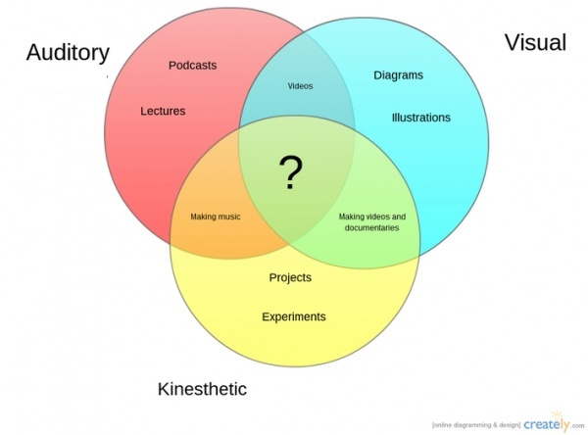
Learning Preferences / Modes of Instruction
Auditory
Kinesthetic
Visual

Slide 16
Learning Preferences / Modes of Instruction
Auditory
Kinesthetic
Visual
The Ideal Instruction Mode Covers All!

Slide 17
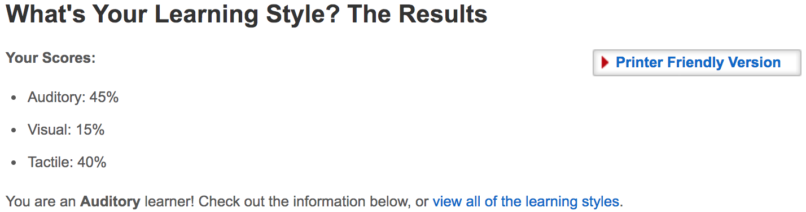
Pete’s Sample Data

Slide 18
Pete’s Sample Data
Auditory + Kinesthetic [Tactile] and not just one in isolation!

Slide 19
Pete’s Sample Data
Auditory + Kinesthetic [Tactile] and not just one in isolation!
Here’s a secret, while these are patterns I have observed, there are times when I’ve gotta “SEE IT” [visual], or I just don’t get it!

Slide 20
Auditory Highlights
The words that supplement
Hearing information
Sound recollection, sounding it out
Reading aloud
Positioning yourself to hear a speaker clearly
Listen to a recording of yourself

Slide 21
Visual Highlights
The visuals [text, diagrams, and so on] that supplement
Viewing information
Sight recollection, the picture in your head
Flashcards
Write things down
Draw a picture / diagram
Use color

Slide 22
Kinesthetic Highlights
The hands-on [tactile] supplements
Using information
Acting out a scenario
Constructing a model
Providing space to do things
Re-writing instructions

Slide 23
Group Activity
Using
https://www.cise.ufl.edu/~pjd/tmp/javadocs/
https://www.cise.ufl.edu/~pjd/tmp/classfiles/
Design
A sample project
List of learning objects
Anticipation [examples] of how experience will develop

Slide 24
Discussion
Consider your lecture environments and experiences:
What was effective?
What was ineffective?
Could something work well in one environment, but not another?

Slide 25
References
If you would like to pursue this further, here are some references:
http://www.leerbeleving.nl/wp-content/uploads/2011/09/learning-styles.pdf
https://www.frontiersin.org/articles/10.3389/feduc.2018.00105/full

